Slide 1
3D Reconstruction using
fringe projections
N.Siddhartha
EE19B029
Supervisor
Dr.Rama Krishna Gorthi

Slide 2
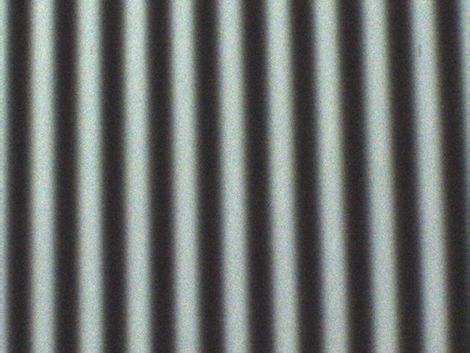
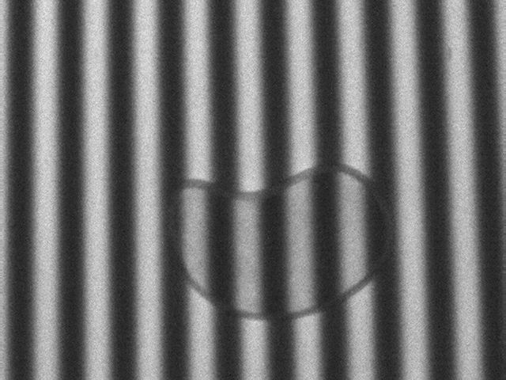
A widely used technique for 3D profiling is Fringe Projection Profilometry. This method operates in a non-contact manner which can produce high resolution images. This method makes use of fringe projections.
Fringe Patterns and Deformed Fringe Patterns:
Fringe patterns are bands of contrasting brightness and darkness produced by interference or diffraction of radiation.
Deformed fringes are observed when fringes are projected onto an object. The height information of the object is stored as the phase shift of fringes.
(a)
(b)
Fig 1:(a)Linear Fringe Pattern
(b)Deformed Fringe Pattern

Slide 3
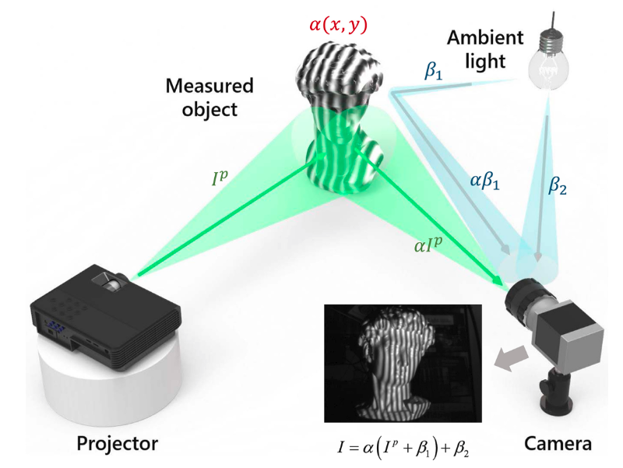
Basic principle behind FPP:
Fringe patterns from a projector are projected onto an object and a picture is taken using a camera to record the deformation in the fringe pattern.
Fig 2: Fringe Projection Profilometry system

Slide 4
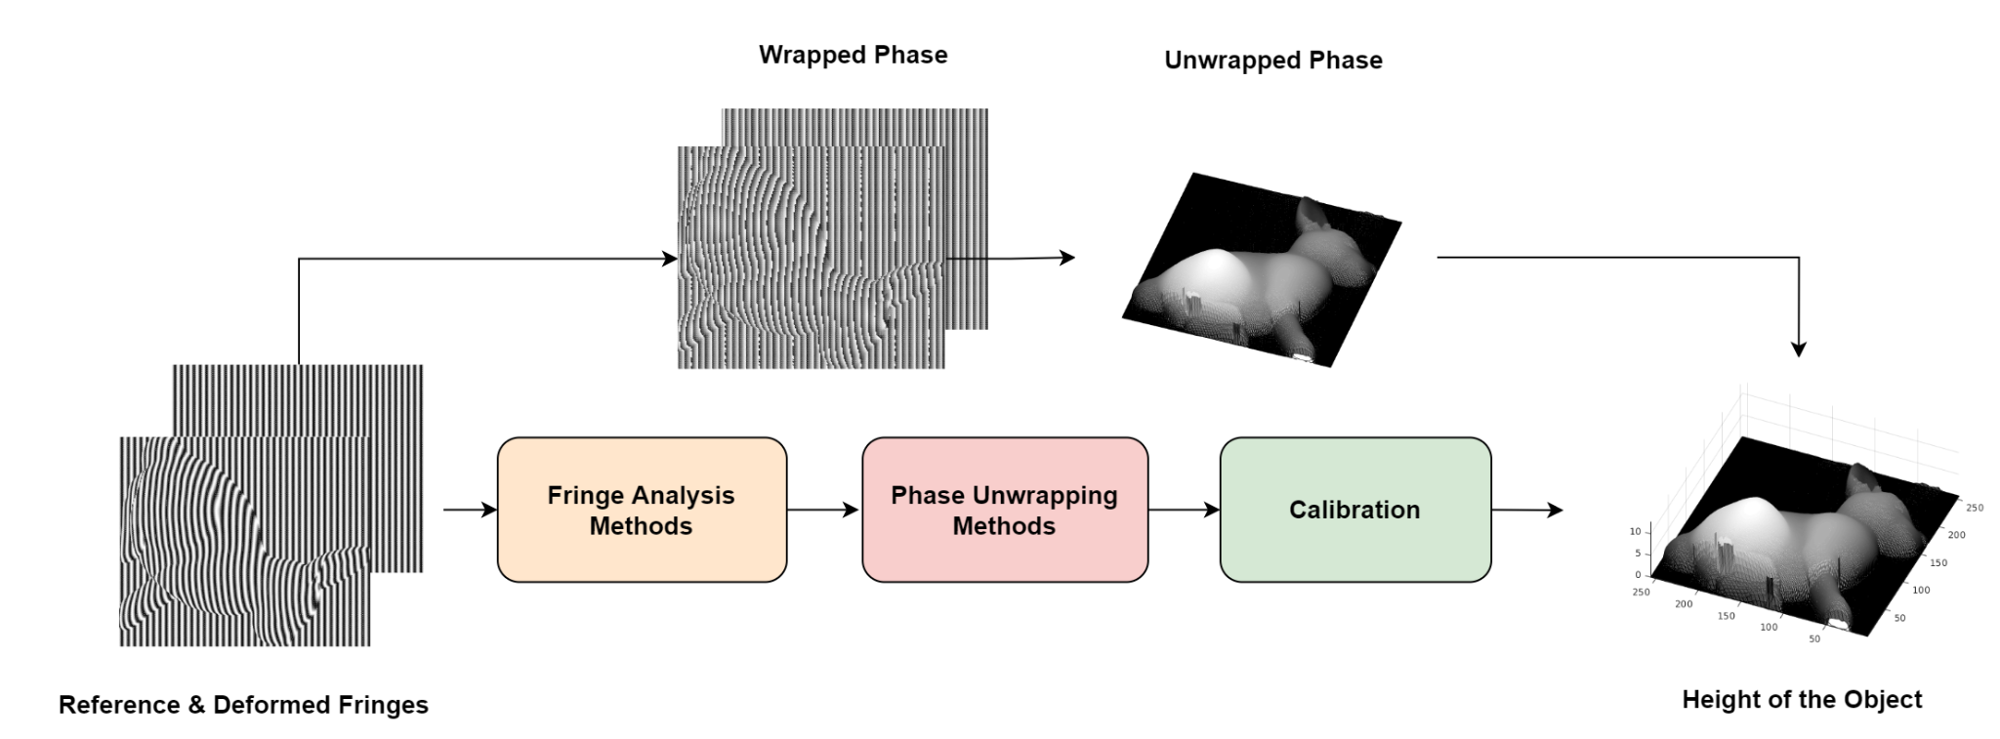
Literature Review
Traditional methods: Traditional methods usually use N-phase shifting method to acquire the wrapped phase map from deformed fringe images. Unwrapping algorithm are then used to find the unwrapped phase map. Calibration methods are used to find the final height map from phase map.
Fig 3: Flow Chart followed by traditional methods

Slide 5
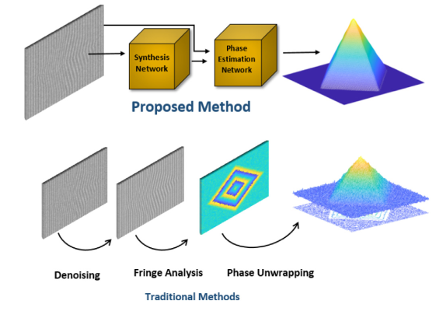
Modern Methods
Modern methods usually Deep Learning based approaches. Conventional methods involves several steps this might increase the error as we move to the next step.
We use these deep learning techniques to find the wrapped/unwrapped phase map directly from the deformed fringes.
Modern DL methods
Fig 4: Difference between modern DL and traditional methods

Slide 6
Problems faced while dealing with real-life scenarios:
Effect of Shadows: When dealing with objects of a significant heights, due to the light illuminated on the object a shadow of formed. This shadow can affect the fringe analysis.
Colour Effect: When the object has some color to it intensity of the deformed fringes are effected.
Saturation Problem: The captured image can have non sinusoidal behavior if the objects are shiny.
Hence, We tried using synthetically generated images.

Slide 7
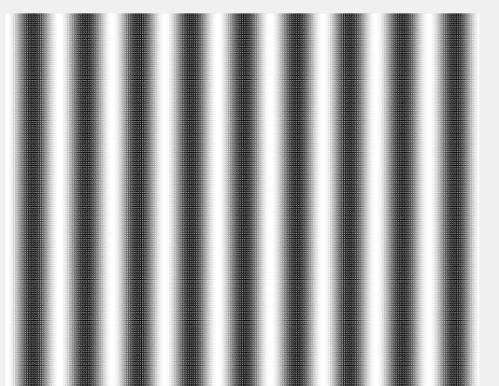
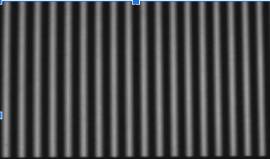
Synthetically generated Fringe Projections:
Most of the literatures used real-life generated data to train the model and test with the same. But we are planning on using synthetically generated data(in Matlab) to train the model and test with real-life data. This method allows use to feed variety of data and generate a more generic model.
(a)
(b)
Fig 5: (a)Synthetically Generated images (b)Reference fringe pattern image taken from camera

Slide 8
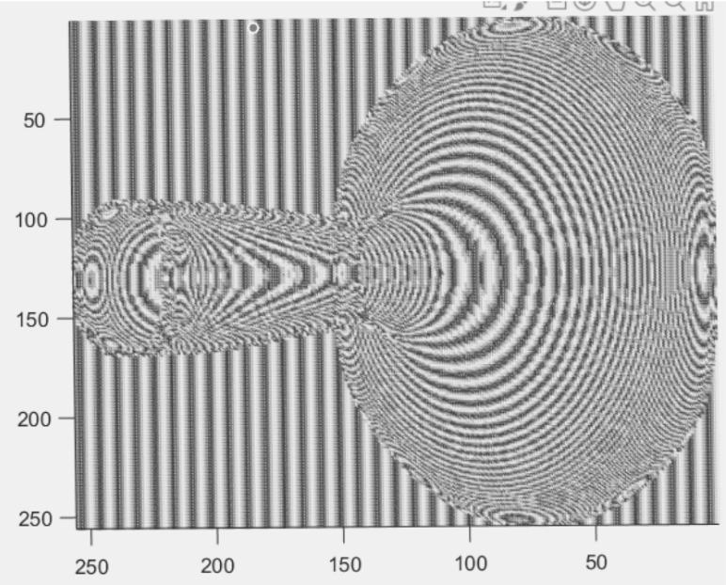
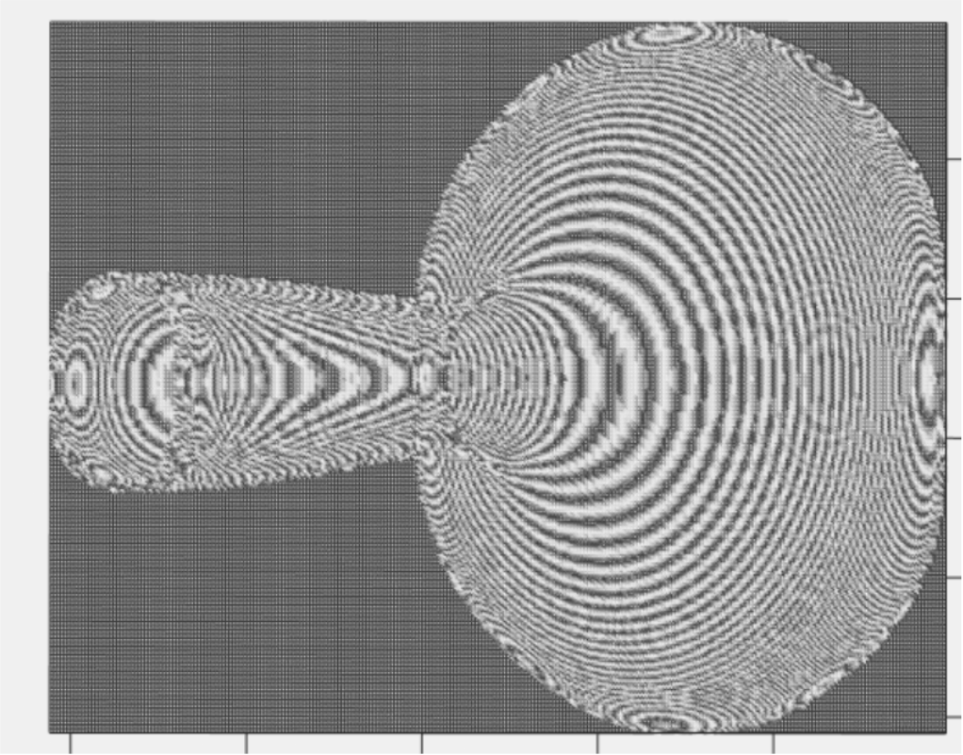
Work done
Objective-1: Elimination of real world problems
Problem 1: Shadow elimination: we have trained a UNet and HNet model with the dataset which has the background masked out this experiment allows us to eliminate the effect of shadows. When an object is placed far away from the background, the effect of shadows negligible.
Dataset Used:
Fig 6: (a) Deformed image with background (b) deformed image without background

Slide 9
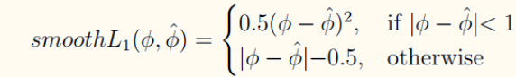
Loss:
We are using smooth L1 loss function for all the experiments.
Here, 𝝓 represents the original phase shift, whereas 𝝓(hat) it represents the predicted phase shift.

Slide 10
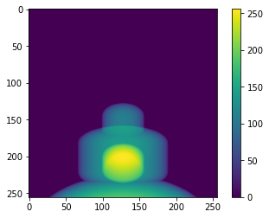
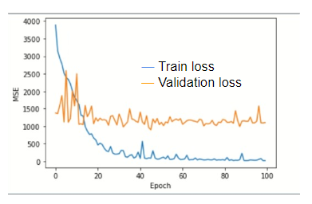
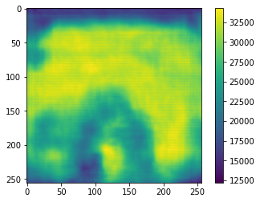
Results (UNet)
Loss graph
Ground Truth
UNet model wasn't able to perform well with our task.
Prediction

Slide 11
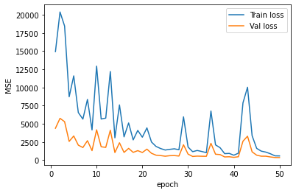
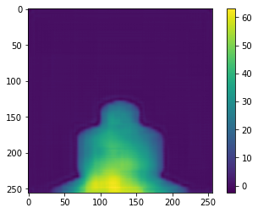
Results (HNet)
Loss graph
Ground Truth
HNet model was converging and the results are also satisfactory and able to perform well with our task.
Prediction

Slide 12
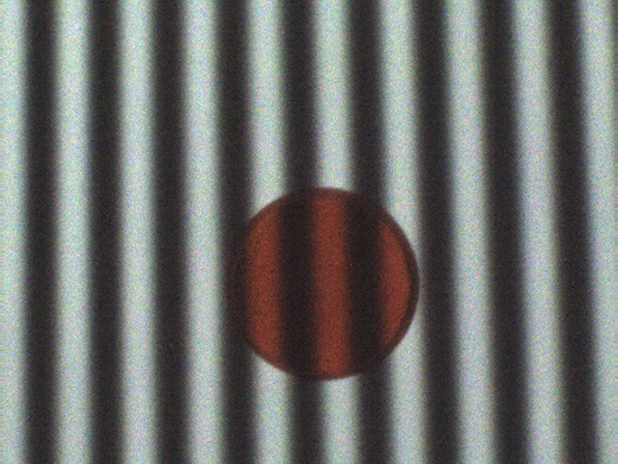
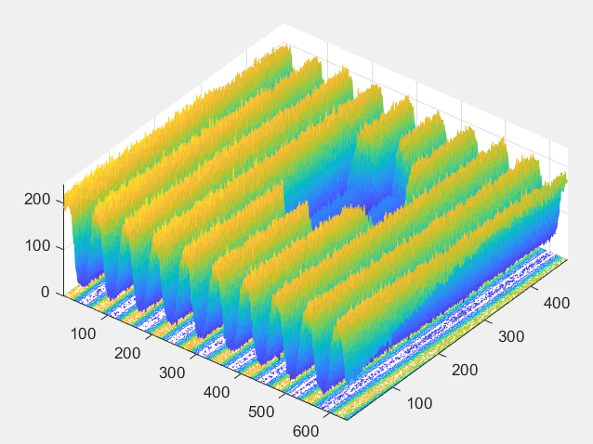
Problem 2: Colour Problem: Since there is a problem with colored objects and to tackle this problem we have to train the model with deformed fringes of colored objects. Since we cannot acquire a data with real objects we have to make them synthetically.
We have to train a PSMNet model with this dataset and test it on dataset acquired from deformed fringes of real objects.
Fig 7:(a) Image taken from the camera (b) 3D view of the deformed fringes

Slide 13
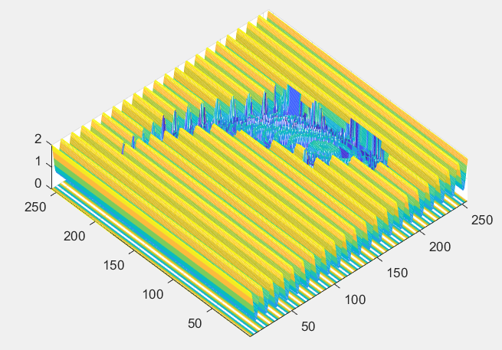
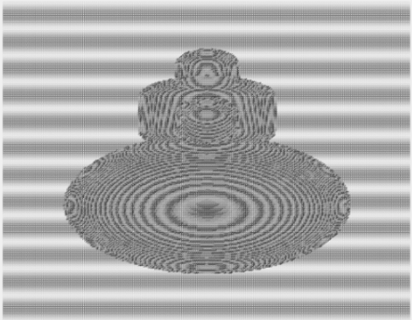
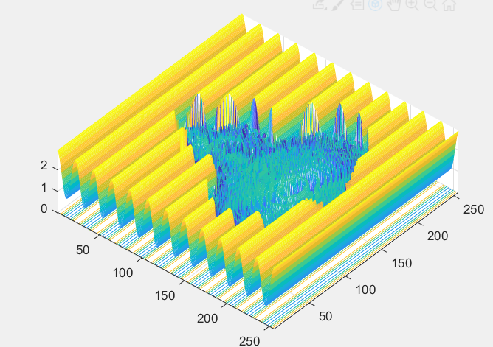
Dataset for colored objects:
To eliminate the effect created by colored objects we have to train a PSMNet model. To achieve this we created a dataset where the object region is masked and the amplitudes in that region are decreased and the fringes are shifted.
Dataset Used:
Fig 8: (a)fringe view at an angle(b) top view

Slide 14
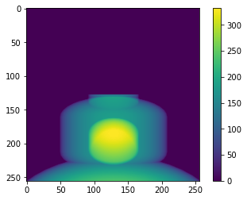
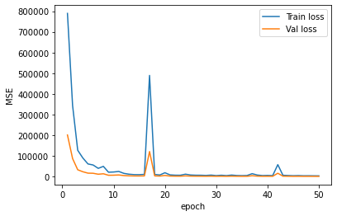
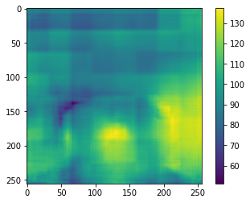
HNet results (colour experiment)
Loss graph
Ground Truth
Even though the validation and train loss are converging the results are not as expected.
Prediction

Slide 15
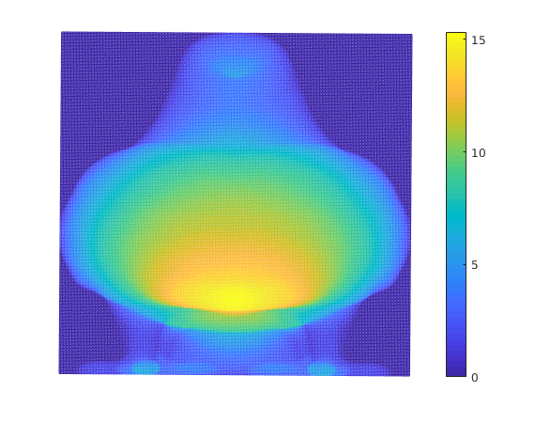
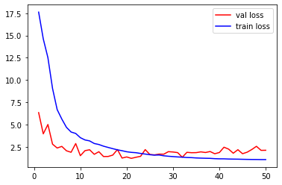
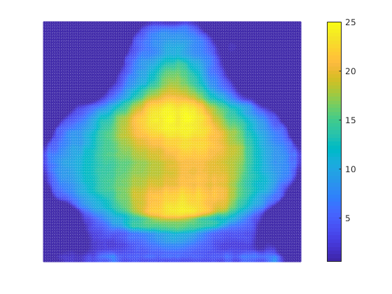
PSMNet results (colour experiment)
Loss graph
Ground Truth
As we can see that the PSMNet model was able to predict the shape and overall object but, we must do some fine tuning and it can perform better.
Prediction

Slide 16
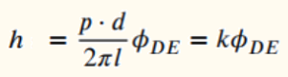
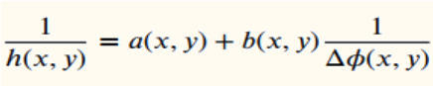
Objective-2:
Calibration: The results we get from the model are usually in phase maps. We have to convert them into a height map/ depth map. Hence we use some standard calibration methods to establish a relation between the 2 quantities.
Types of calibration
Linear method: We assume the relationship between the phase and height is linearly varying. Since they are linear, a line would fit the points of (phase, height).
Inverse Phase-height calibration: We assume that the relationship between phase and height is as follows-

Slide 17
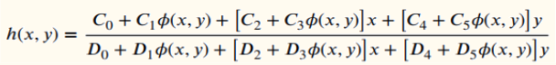
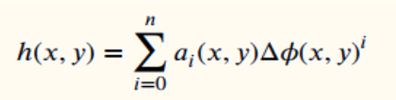
Governance Equation: Based on experimentation and analysis, a relationship between phase and height is established as follows-
Polynomial calibration: Height is represented as a function of the phase where this function is usually polynomial.

Slide 18
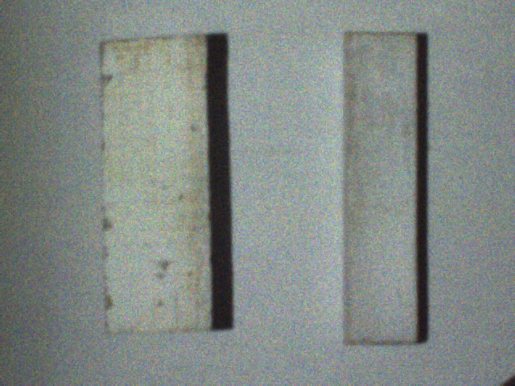
We have used wooden block objects of 3 sizes for fitting the above curve. And 3 objects for testing the methods.
Fig 9: objects used for calibration
Fitting objects sizes: 22.5mm,42mm and 56mm
Validating objects size: 45mm and 2 objects with variable height.

Slide 19
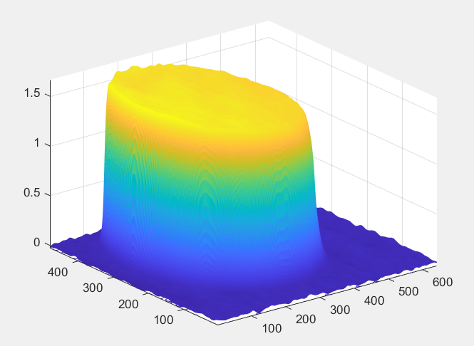
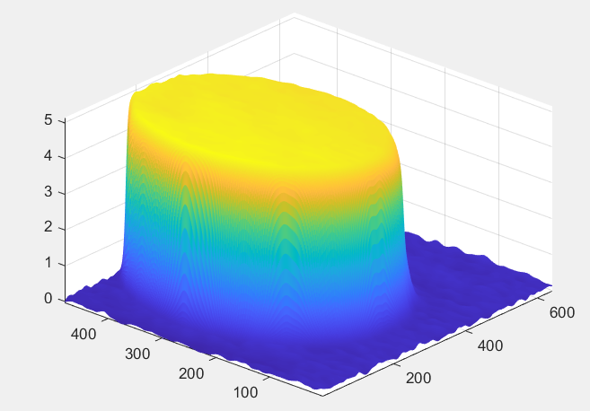
Calibration Results: After implementing all the above calibration methods we were able to find the height map from phase map. Ground truth height of this object is 45mm.
Fig 10: (a)Phase map(b)Resultant height map from 2nd-degree polynomial calibration

Slide 20
Quantization of errors:
We are using RMSE and MAE to find the error of the predicted with the ground truth.
Method Used | Linear Method | Inverse Method | Governance Eq. | Polynomial (Deg 1) | Polynomial (Deg 2) | Polynomial (Deg 3)
RMSE(in cm) | 2.0913 | 0.7082 | 0.4987 | 0.5325 | 0.5134 | 0.5313
MAE(in cm) | 1.4727 | 0.4596 | 0.3167 | 0.2764 | 0.3326 | 0.3479

Slide 21
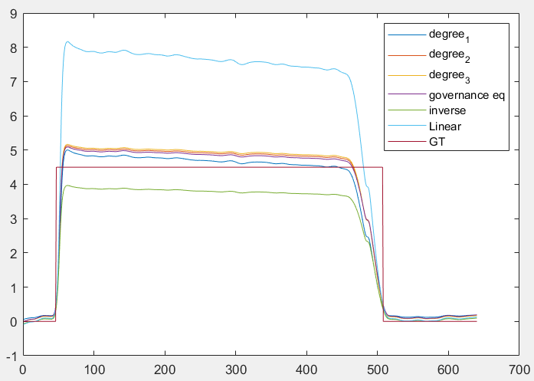
Comparative view
A comparative view of the calibration was achieved after implementing all the calibration methods. Analysing this tells us that the polynomial method with degree 1 and Governance equation is working better than the rest.
Fig 11: Comparison of calibration methods

Slide 22
Future scope
A crude result for Shadow and Colour Problem were established using HNet and PSMNet respectively. Further fine tuning can ultimately improve the predictions.
Shadow experiment can be taken to further steps by increasing the synthetically generated dataset from blender.
Establish an end-to-end framework for colored objects that works best for real-life objects.
Establishing calibration volume which can work best for any setup.

Slide 23
Resources
Triggs, B., McLauchlan, P.F., Hartley, R.I., Fitzgibbon, A.W. (2000). Bundle Adjustment — A Modern Synthesis. In: Triggs, B., Zisserman, A., Szeliski, R. (eds) Vision Algorithms: Theory and Practice. IWVA 1999. Lecture Notes in Computer Science, vol 1883. Springer, Berlin, Heidelberg. https://doi.org/10.1007/3-540-44480-7_21
S. S. Gorthi and P. Rastogi, “Fringe projection techniques: whither we are?” Optics and lasers in engineering, vol. 48, no. ARTICLE, pp. 133–140, 2010.
Y. Hu, J. Xi, J. F. Chicharo, W. Cheng, Z. Yang, Inverse Function Analysis Method for Fringe Pattern Profilometry, IEEE Trans. Instrumentation and Measurement Article in Press
V. Srinivasan, H. C. Liu, and M. Halioua, "Automated phase-measuring profilometry of 3-D diffuse objects," Appl. Opt. 23, 3105-3108 (1984)
Andrew-Hieu Nguyen, Khanh L. Ly, Charlotte Qiong Li, and Zhaoyang Wang, "Single-shot 3D shape acquisition using a learning-based structured-light technique," Appl. Opt. 61, 8589-8599 (2022)
Ronneberger, O., Fischer, P., & Brox, T. (2015). U-Net: Convolutional Networks for Biomedical Image Segmentation. arXiv. https://doi.org/10.48550/ARXIV.1505.04597
Zhou, Z., Siddiquee, M. M. R., Tajbakhsh, N., & Liang, J. (2018). UNet++: A Nested U-Net Architecture for Medical Image Segmentation. arXiv. https://doi.org/10.48550/ARXIV.1807.10165
Machineni, R. C., Spoorthi, G. E., Vengala, K. S., Gorthi, S., & Gorthi, R. K. S. S. (2020). End-to-end deep learning-based fringe projection framework for 3D profiling of objects. Computer Vision and Image Understanding, 199, 103023. https://doi.org/https://doi.org/10.1016/j.cviu.2020.103023
Feng, S., Zuo, C., Zhang, L., Tao, T., Hu, Y., Yin, W., Qian, J., & Chen, Q. (2021). Calibration of fringe projection profilometry: A comparative review. Optics and Lasers in Engineering, 143, 106622. https://doi.org/https://doi.org/10.1016/j.optlaseng.2021.106622
Chang, Jia-Ren, and Yong-Sheng Chen. Pyramid Stereo Matching Network. arXiv, 2018, https://doi.org10.48550/ARXIV.1803.08669.

Slide 24


